Slide 1
L. 1 Plants biotechnology
History of Plant biotechnology
Hybrid breeding
Modern Plant breeding
Why plant biotechnology?

Slide 2
The word "biotechnology" was first used in 1917 to describe
processes using living organisms to make a product or run a process, such as industrial fermentations. Biotechnology began when humans started to plant their own crops, domesticate animals, ferment juice into wine, make cheese, and leaven bread.
Present definition of biotechnology “Any technological application that uses biological systems, living organisms, or derivatives theory, to make or modify
products or processes for specific use’’
Plant biotechnology
“Plant biotechnology describes a precise process in which scientific techniques are used to develop useful and beneficial plants’’

Slide 3
The field of plant biotechnology is concerned with developing ways to improve the production of plants in order to supply the world’s needs for food, fiber and fuel.
In addition, plants provide us with many pharmaceuticals and industrial compounds.
As our population grows, our needs also grow.
To increase the quantity of crop production as well as to produce specific characteristics in plants, biotechnologists are using selective gene techniques.

Slide 4
History of Plant biotechnology
Early Plant breeding
Humans domesticate crops.
• Breed plants to further improve desirable characteristics.
Plant breeding 12,000 years ago

Slide 5
Traditional plant breeding selects mutants for best yield and quality (e.g., tomatoes).
1. Classical Plant breeding.
2. Cross-breeding to strengthen traits.
Charles Darwin publishes the theory of evolution by natural selection. The founding of the science of genetics.
Gregor Mendel discovers the laws of inheritance by studying flowers in his garden. The science of genetic begins.

Slide 6
Hybrid breeding
Two parental lines of normally outbreeding species are inbred through several self-pollinations.
• When crossing such lines the first generation has hybrid vigour.
• The vigour gradually disappears over the next generations so new sowing seeds have to be purchased every year .
• Selection operates on desirable traits, not on survival in the wild.

Slide 7
Modern Plant breeding
A basic type of modern plant breeding:
- Mutation breeding
- Green revolution
- Plant tissue culture breeding

Slide 8
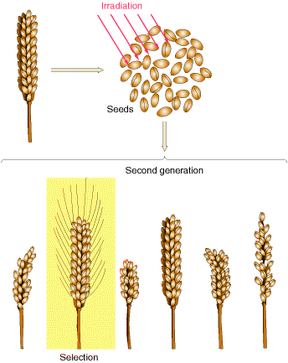
Mutation breeding
Seeds are treated with
either radiation or
mutagenic chemicals to induce larger or smaller
lesions in the genes.
- The mutations are at random over the genome.
- Usually mutation results
in a loss of function of
Genes.

Slide 9
Green revolution (1960-1970)
Green revolution’ leads to greatly increased crop yields based on the incorporation of dwarfing genes discovered by Norman Borlaug and the widespread use of agrochemicals.

Slide 10
Plant tissue culture breeding
The process of selectively mating plants in aseptic culture.
- Embryo rescue
- Somaclonal variation selection
- Somatic hybrid (i.e. fusion protoplast).
- Generation of haploid (i.e. anther/microspore culture)

Slide 11
Highlights of Plant tissue culture
1902. Gottlieb Haberlandt proposed that all cells are totipotent. Totipotent.
Totipotency (Lat. totipotentia, "ability for all [things]") is the ability of a single cell to divide and produce all of the differentiated cells in an organism.
Spores and zygotes are examples of totipotent cells.
In the spectrum of cell potency, totipotency represents the cell with the greatest differentiation potential, being able to differentiate into any embryonic cell, as well as extraembryonic cells. In contrast, pluripotent cells can only differentiate into embryonic cells

Slide 12
History of Plant biotechnology
1904
Hanning isolated nearly mature zygotic embryos from seeds of Crucifers and successfully grew them to maturity in a defined medium.
1925
Laibach isolated and grew embryos of interspecific cross Linum perenne and L. austriacum that aborted in vivo
1948
Folke Skoog discovered that kinetin could induce organogenesis in callus culture of tobacco.

Slide 13
1957.
Skoog and Miller demonstrated the effects and interaction of phytohormones
Auxin : cytokin > 1 root formation
Auxin : cytokin <1 shoot formation
Auxin : cytokin = 1 callus formation

Slide 14
History of Plant biotechnology
1964
Haploid plants derived from cultured Datura anthers
1972
First interspecific hybridization of Nicotiana sp. by fusing protoplast
1974
Haploid plants derived from cultured tobacco microspores
1977
Successful integration of T-DNA in plants.

Slide 15
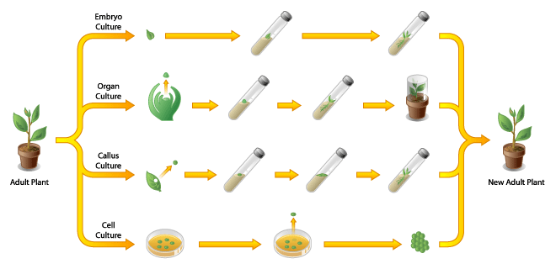
Two major areas of plant biotechnology:
- Plant Tissue Culture (plants cloning)
Recombinant DNA technology (gene cloning)

Slide 16
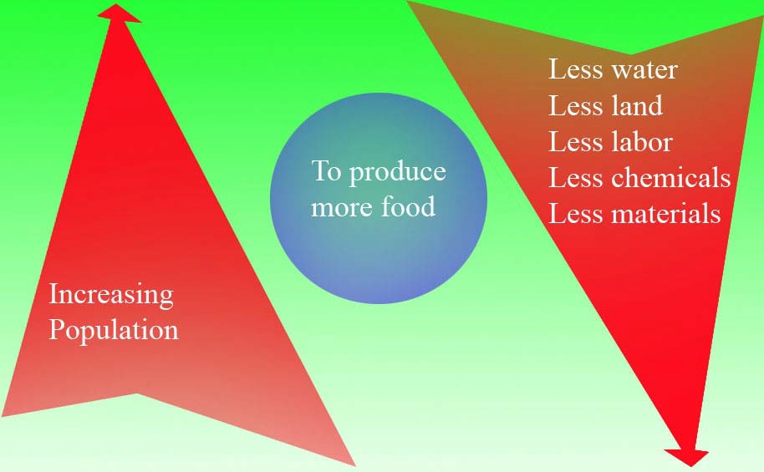
Why plant biotechnology?
Human population is rapidly outgrowing.
Worlds’ current status

Slide 17
For higher yield
Conventional Breeding
Ideotype Breeding
Hybrid Breeding
Wide Hybridization
Mutation Breeding
Germplasm Breeding

Slide 18
The scope of plant biotechnology
Plant genetic engineering
Plants micropropagation
Plant mutation cloning
Plant cells technology

Slide 19
Impact of plant biotechnology
More crop
More money
With full adoption of biotechnology, aggregate income forall regions, measured by gross national product (GNP), is estimated to rise by US$210 billion a year, by the end of the period (2006-2015).

Slide 20
Environmental impact
In vitro conservation
Pesticide reduction

Slide 21
Health impact Society impact
More food
Better food
Society impact

Slide 22
Plant Tissue Culture (PTC):
Plant tissue culture is the sterile, in vitro cultivation of plant parts. Plants have the ability for differentiated cells revert to an undifferentiated state called callus.
These cells will then divide and then differentiate back to somatic embryo cells that will regenerate the entire plant.

Slide 23
Plant Tissue Culture (PTC):
Plants cultured in vitro yield thousands of genetically identical plants (clones) from a single plant.
This process is called micropropagation and is used to commercially propagate plants asexually.
The rapid multiplication allows breeders and growers to introduce new cultivars much earlier than they could by using conventional propagation techniques, such as cuttings.

Slide 24
Plant Tissue Culture (PTC):
Through the use of biotechnology, desirable genetic traits can be transferred from one organism to another by transfer of DNA.
Many more plants with the desirable DNA can be regenerated from small pieces of the transformed plant tissue.
Examples of plants produced using tissue culture include the large variety of ornamental plants; agricultural crops such as strawberry, banana, potato, and tomato; and a variety of medicinal plants.

Slide 25
Plant Tissue Culture (PTC):
Commercial tissue culture involves exposing plant tissue to a specific regimen of nutrients, hormones, and light under sterile conditions to produce many new plants over a very short period of time.

